Slide 1

AIAA REGION V STUDENT PAPER CONFERENCE
DR. DONNA GERREN
AIAA CU BRANCH
FACULTY ADVISOR
Monday, Jan. 23rd, 2017

Slide 2
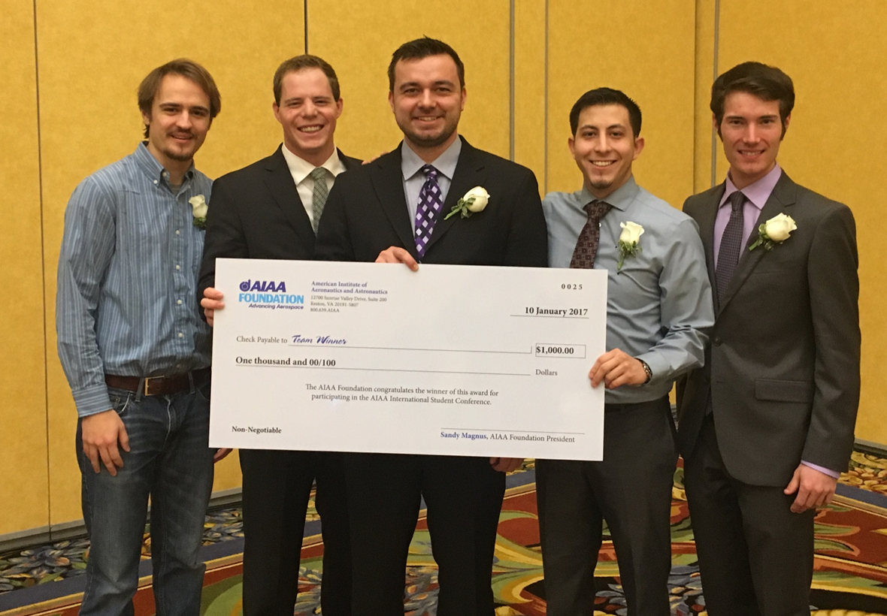
1st Place, AIAA SciTech 2017 International Student Conference: Senior “Project ELSA: Europa Lander for Science Acquisition."
The team was sponsored by Ball Aerospace and Technologies Corp.

Slide 3
AIAA Paper Assignment
This assignment is representative of conference papers that are often used is the aerospace industry to communicate accomplishments to the wider professional community.
The assignment is intended to give design teams a first-hand experience in communicating their work in this format, and it enables teams to present their work at the AIAA Student Conference, if they desire to attend.

Slide 4
AIAA Paper Assignment
This paper is a required element of ASEN 4028 and counts 5% towards your grade this semester. However, conference submission and attendance is NOT required for this course.
Your paper can be on any aspect of your project- you don’t have to write about the whole system.
The papers can be organized in any reasonable form, but formatting must follow the guidelines in the AIAA Manuscript Preparation Kit carefully. This is posted online under the AIAA Student Paper Conference Presentation tab in the Senior Projects D2L site.

Slide 5
AIAA Paper Assignment
The following organizational guidelines are suggested:
Abstract
Introduction
Design Objectives
Design Methodology
Design Results
Conclusion
Results

Slide 6
Conference Information
Conference includes colleges & universities within a 10 state region.
Hosted by AIAA Rocky Mountain Section in Denver this year at Metro State University.
Dates of conference are Friday, April 7 – Saturday, April 8, 2017.
Senior Projects Course ASEN 4028 does NOT require your team to participate in the conference.

Slide 7
Why Should I Go?
The AIAA Region V conference provides an opportunity to:
Present your group’s work to your peers and industry professionals.
Good experience for your professional development & a plus on your resume.
Meet students from other colleges & universities in your field.
Represent your department, college & university at a recognized venue.

Slide 8
Where Do We Start?
You must be an AIAA member to attend the conference, even if you are not actually presenting at the conference, or are an author on the paper and don’t attend. You can join online:
www.aiaa.org
Any person planning to attend the conference must register for the conference . Registration is now open on the conference website:
https://region5.aiaastudentconference.org/

Slide 9
Registration
Online registration is open at this time.
Late registration can be done in person during conference check-in.

Slide 10
Preparing Your Abstract
Abstracts explain the purpose, goal, and methods of your project with a brief summary of the results.
They are typically only 100-200 words, put in paragraph format.
Follow the guidelines in the AIAA Author Kit to prepare your abstract.

Slide 11
Determination of Satellite Characteristics through Visible Light Intensity Analysis
C2C Shane Bruski1 and C2C Samuel R. Harms2
Department of Astronautics, United States Air Force Academy, Colorado, 80841
While many governments attempt to obtain information about satellites passing overhead using expensive equipment such as radar or large telescopes, many characteristics of a satellite, its orbit, and possible mission type can be inferred through analysis of its light intensity variations as it passes overhead. Using off-the-shelf equipment, a satellite can be tracked and recorded with a camera during visible sightings. Images are corrected for range, atmospheric effects, and the percentage of satellite illumination. A history of the intensity versus time is created from these images. Based on patterns displayed by the light intensity graph, a satellite’s cross-sectional ratio, its orientation to the earth, and its movement in the orbit can sometimes be determined. This inexpensive and easily duplicated process is done with only light intensity analysis. The satellite itself need not actually be resolved in the images.

Slide 12
KRAKEN: Kinematically Roving Autonomously Kontrolled Electro-Nautic
Torin Clark, Peter Klein, Geoffrey Lake, S Lawrence-Simon, Joshua Moore, Ben Rhea-Carver, Marek Sotola, Steven Wilson, Christina Wolfskill, Albert Wu University of Colorado at Boulder, Aerospace Engineering Sciences
KRAKEN is an autonomous underwater vehicle (AUV) designed by a team of undergraduate aerospace engineering students at the University of Colorado Boulder. The vehicle incorporates Vortex Ring Thrusters (VRTs), which are bio-inspired thrusters previously designed at CU Boulder. The VRTs, which mimic the propulsive mechanism of squids, can propel the vehicle laterally and allow it to execute zero-radius yaw rotation while maintaining a low external profile with minimal drag. KRAKEN is a torpedo-shaped vehicle without control surfaces that can move at high speeds while still being able to execute precise maneuvers with the VRTs. In addition to the thrusters, the vehicle has a suite of onboard sensors to determine its relative position, velocity, and attitude. This information is used in conjunction with a customized image recognition system to autonomously traverse an underwater course designed to exercise the novel technologies and abilities of the vehicle. An embedded LabVIEW system processes this information and provides autonomy and closed-loop feedback control capabilities.

Slide 13
Abstracts
Abstracts are due February 3rd for your ASEN 4028 class assignment.
Abstracts are due February 10th for the AIAA student paper conference.
This will allow your advisor time to review and suggest improvements to your abstract before conference submittal.

Slide 14
Submitting Your Team’s Abstract – Due Friday, February 10th, 11:59:59pm
Only the AIAA team lead will submit your team’s abstract. The team lead can be the PM, the SE, or any team member the team wishes to appoint to this position for the conference. The team lead will be the POC for the conference
Submission Process:
1. Register for the conference.
2. Create/join your Technical Paper on the "My Registration" page.
3. When you create your Technical Paper the form will include a text field for you to type your abstract in. Your abstract should be a BRIEF description of your manuscript.
4. The Student Activities Committee will then have the opportunity to approve, deny, or ask for an updated abstract.
5. You will be notified via the email you listed on your registration form the status of your abstract and if you need to make any updates.
Your abstract will be evaluated to determine that your work is appropriate for inclusion into the conference.

Slide 15
What If We Change Our Minds About Going?
If you are unsure whether you or your team is going or not, submit your abstract anyway. You CANNOT decide you want to present after February 10th if you have not submitted your abstract. After that date, entry is closed.
If you find that you just don’t have the time to finish your paper before it’s due, or you can’t afford the time away from school, simply have your team lead contact the conference organizers via e-mail and ask them to pull your abstract and cancel any registrations you or your team members have made.

Slide 16
Contact Information
Contact Information
Region V Deputy Director for Education
ANGELA W. SUPLISSON, Col, USAF
US Air Force Academy
719-333-2427
Angela.Suplisson@usafa.edu
Metropolitan State University Student Section Officers
SHAWN SLOAN
MSU Denver Student Branch Vice-Chair
(303)596-8856
ssloan12@msudenver.edu
United States Air Force Academy Student Section Officers
JEFFREY M. LAYNG
USAFA Student Branch Chair
(814)441-1268
ssloan12@msudenver.edu
Contact one of them as soon as you are certain you or your team can’t attend – it’s professional courtesy.

Slide 17
Paper
Papers are due March 10th for your ASEN 4028 class assignment.
Papers are due March 17th for the AIAA student paper conference.
This will allow your advisor time to review and suggest improvements to your paper before conference submittal. You must have your project advisor’s approval before submitting to the conference.

Slide 18
Preparing Your Paper
For your class assignment, or in order to be eligible to compete in the AIAA Region V Student Paper Conference, papers must comply with standard AIAA professional conference format.
The length of each paper will be limited to 11 pages, single-spaced, including the abstract, references, figures and appendices. Consult the AIAA Author Kit to prepare your paper.
You are allowed to deviate somewhat from the original abstract you submitted, but the general subject material must be the same.

Slide 19
Submitting Your Team’s Paper – Due Friday, March 17th, 11:59:59pm
Only the AIAA team lead will submit your team’s paper.
Once your abstract is approved, you will then be allowed to upload your manuscript (pdf only). The Student Activities Committee will then have the opportunity to approve, deny, or ask for an updated manuscript. Again, you will be notified via the email listed on your registration form the status of your manuscript.
The conference organizers will contact the team lead if the paper has been rejected. The main reason for rejection is that the paper does not conform to AIAA format. The organizers will most likely contact the lead and give your team a couple of days to fix the problems and resubmit.
Your paper will then be distributed among industry professionals, usually 3 different engineers, to read and evaluate. Your entry will receive a written score based off this evaluation.

Slide 20
Between Paper and Presentation
Look at the conference website on a daily basis. The conference organizers will post the presentation schedule. Be aware of when you are slated to present. If there is any problem at all with the time slot, contact the organizers immediately and ask if it would be possible to reschedule your team. Only do this in an extreme case, not for your convenience.
Start on your presentation as soon as your presentation as soon as your paper has been submitted and practice, practice, practice.
Dr. Nabity has scheduled class time for a practice and critique session in ECCR 200 on April 3rd and 5th. Please invite faculty to attend as well as your customer, friends, relatives,…. for feedback.

Slide 21
Preparing Your Presentation
Your presentation is not uploaded on the conference website, and is not “due” until you give it.
A PC and projector will be provided for presentations.
You may use your own PC, if you prefer, as long as it can be hooked up, powered on and ready to go in the 2 minute allotted time. Preparation time extending into your 20 minute presentation time will count as part of your 20 minutes.
The preferred format of presentation is a PowerPoint file stored on CD-ROM or flash drive. Please bring your file in multiple formats in case of technical difficulties.
To ensure that there is a smooth transition between the presenters, all visual aids can be required to be uploaded onto the session computers during check-in if you plan on using these computers.
Keep in mind that the oral judges are not the same as the written judges, and have NOT read your paper.

Slide 22
Presenting Your Presentation
All presentations are scheduled at 30 minute intervals.
These thirty minutes include the time for speaker introduction as well as paper presentation and questions and answers.
Each presentation will be given a maximum of 20 minutes. A five-minute warning, then a one-minute warning, is usually given to help the speaker pace the end of the presentation.
If needed, a cut-off at the end of twenty minutes will be enforced.
Additional time (approximately 8 minutes) will be allotted for questions from the floor, starting with the judges.
You will receive an oral score from each of these judges, usually three in number.

Slide 23
Final Scores
Your team’s final score will be the combined values from the written evaluation, added with the oral presentation scores.
The three top scores will earn first, second and third place, respectively.
AIAA Regional Student Conference prize amounts per winning entry are: first place-$500; second place-$300; third place-$250. The first place team will be invited to participate in the national competition in January 2018 in Kissimmee, Florida.
Other teams will not receive their relative ranking.
All teams will receive a packet containing the judges’ evaluations of their papers and presentations.
Awards will be announced at the awards banquet Saturday, April 8th.

Slide 24
What to Expect Friday, April 7th
There may be an early reception for late registration and/or to pick up a schedule of events.
Presentations will commence, usually at 8am, and run until lunch time. There is usually a brief 15 minute break in the morning around 10am.
Depending on the number of papers being presented, there may be 2 concurrent sessions being run. If so, be aware of which room you will be presenting in.
If there are 2 concurrent sessions, you are allowed to move between rooms at the end of each speaker’s presentation, but not during presentations, please.
There will be an hour from noon – 1pm for lunch, then presentations commence and end at 3pm. Lunch is usually provided by the conference on Friday.
Friday evening is traditionally “on your own” for dinner.

Slide 25
What to Expect Saturday, April 8th
Presentations will again commence at 8am and run until around noon, when they are finished.
Lunch is on your own.
The afternoon is needed by the judges to go over the scores and determine the winners, so you have free time until the awards banquet or there may be a tour of a local engineering facility.

Slide 26
What to Expect Saturday Evening
The banquet will be held at Metro State University.
The banquet usually commences around 5:30pm with dinner, then a speaker, to follow.
Awards are announced and judge’s comments are delivered at this time.
We go around and personally thank the organizers for all their work and for putting on the conference before we leave. You may leave immediately afterwards.

Slide 27
What We Expect From You
You are representing your university, college and department and will be expected to conduct yourselves accordingly.
The faculty here are very proud of you and the work you have been selected to present, whether or not you place in the final standings - you are already in an elite group.

Slide 28
More of What We Expect From You
Dress for YOUR presentation (and the awards banquet) should be business formal - 'suits and ties' kind of attire. You may also wear team shirts with nice slacks if you have team polos.
If/when you are not presenting, you should still look professional (business casual).
You are expected to attend the other papers at the conference if possible.
The department may help subsidize your trip. Talk with Joanie Wiesman about available funds for mileage.

Slide 29
What I Expect From You
We will be Team CU during this conference. I will be attending and would like to know as soon as possible who else is going out and what teams you are representing.
It might be possible to share rides so it would be helpful to know how many cars we have and what peoples’ schedules to/from Denver are going to be.
PLEASE plan enough travel time to deal with inclement weather along the route and, if conditions are really treacherous, there is no conference worth risking your life to get to.
Feel free to call on me for help before the conference and during the conference. I am the CU AIAA Faculty Advisor and I’m there to assist you any way I can.
I do have some previous years’ papers which are posted online under the AIAA Student Paper Conference Presentation tab in the Senior Projects D2L site.

Slide 30
QUESTIONS?

